Slide 1
Cloud Computing
Vincent Daugherty
Bryce Gaylord

Slide 2
This section of code sets up the header for the home page.
The Navbar at the top is anchored to links below and will scroll to that section of the page when clicked.

Slide 3
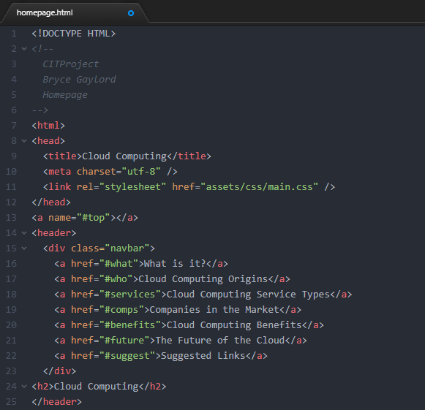
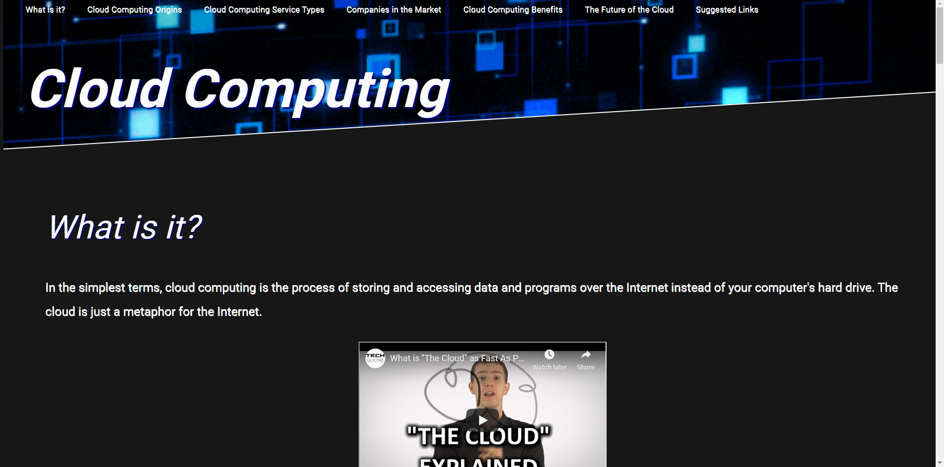
Home Page

Slide 4
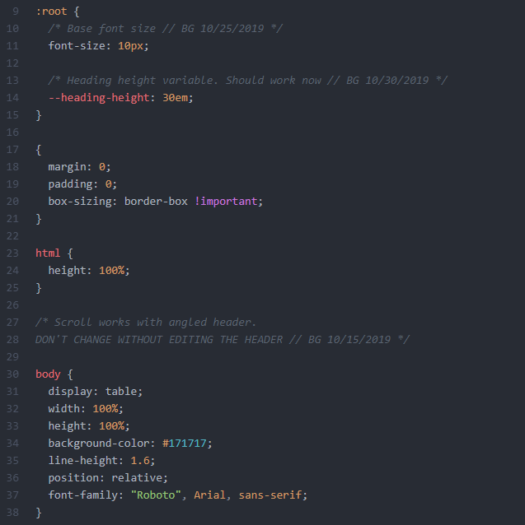
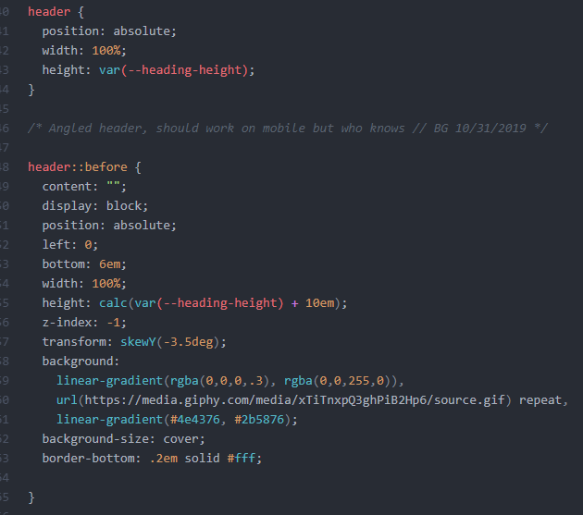
The CSS for the header calculates the height and adjusts to fit the user’s screen type, as well as adjusts the skew of the header via skew Y. The background elements of the header are linked via URL. The body is set to a table display with an import Roboto font.

Slide 5
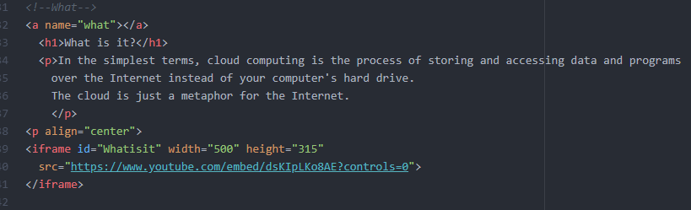
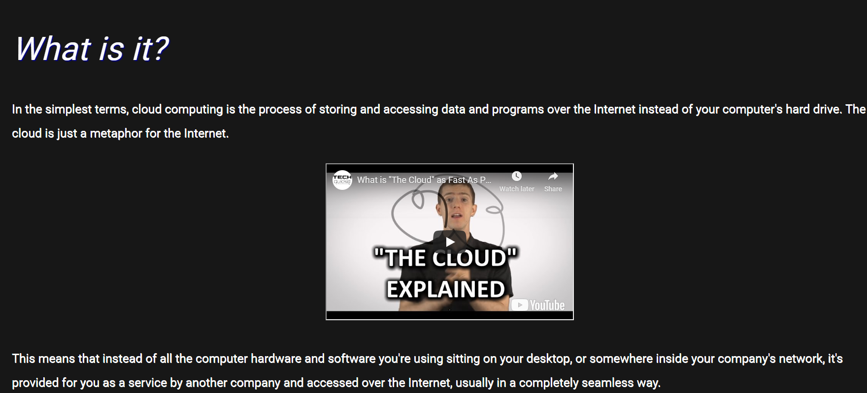
Paragraph Elements

Slide 6
The paragraphs for the site are anchored to the navbar by the <a name=“##”></a> anchor ID tag. =“what” in this case.
Within each paragraph are <h1> headings, <iframe> for video control and sizing, and a <p align=“center” to keep the video elements in the center of the page at all times.

Slide 7
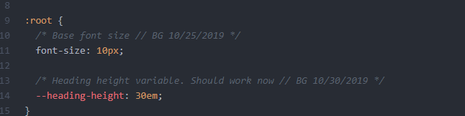
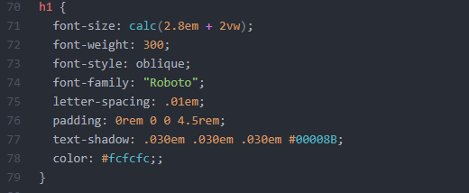
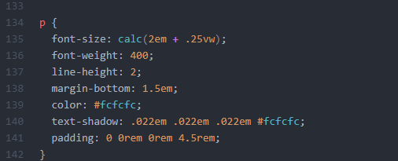
The CSS for the h1 element and the paragraph element. The font size is calculated to fit the user’s preferred screen size and refers to the original root element size of 10 pixels.

Slide 8
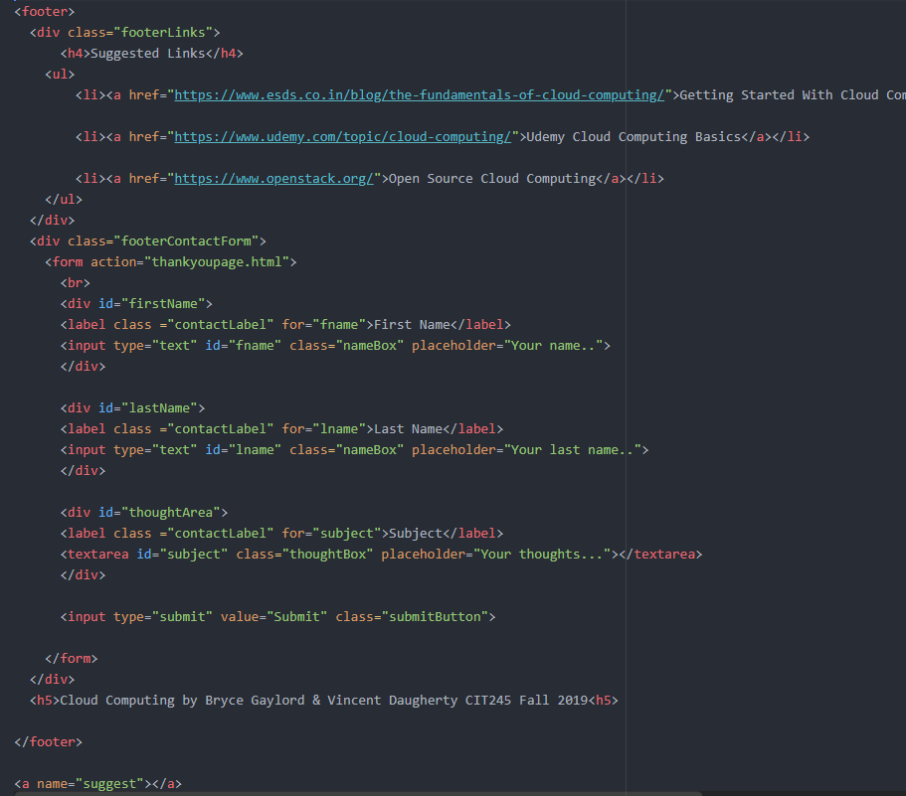
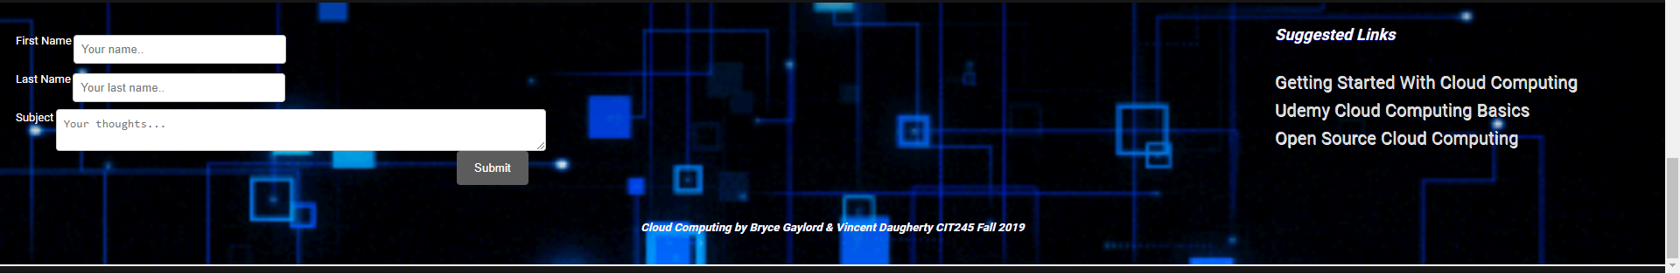
The Footer

Slide 9
The footer contains suggested links to helpful cloud computing websites.
The footer also contains a responsive “contact us” box that links to a thank you page.

Slide 10
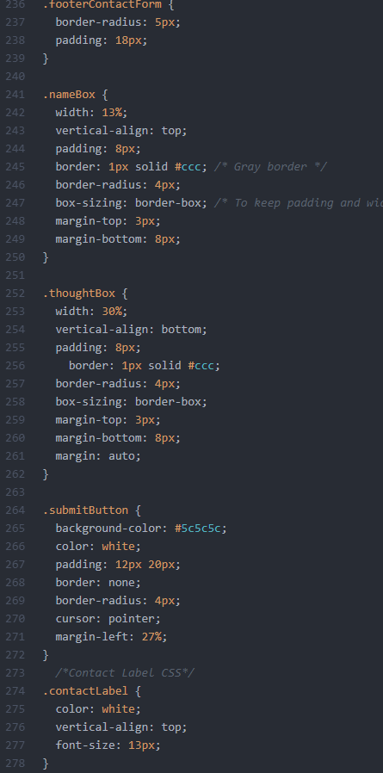
The CSS for the contact us box. This allows for the responsive dialog box so that users may adjust the window in which they are typing.

Slide 11
